Slide 1
Data visualization - Energy
Victor Nicolausson

Slide 2
The dataset - Climate data from kaggle
17432 x 122 ~ 2.3M datapoints
Libraries used: GeoPandas and Pandas along with several others.
Merged with a GeoPandas GeoDataFrame containing geodata for all countries (existing today)
After some cleaning and imputing, down to 20682 x 29 ~ 600k datapoints
GeoPandas uses GeoDataFrames to allow for handling of geographical data: Regions Coordinates Used for plotting with maps
Most of time spent dealing with learning new libraries and data types

Slide 3
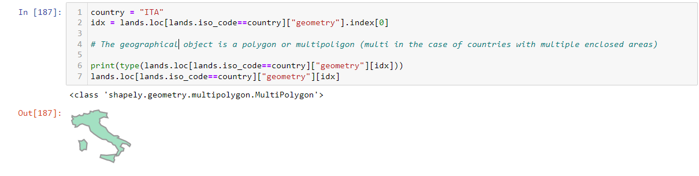
Plottable objects - polygons make up areas

Slide 4
Results!
Plots generated with GeoPandas, Geoplot and seaborn, showing colored world maps and line plots describing the development of production levels of various energy sources.
Fossile energy sources (oil, coal, gas)
Renewable/”Clean” energy sources (wind, solar, water etc. + nuclear)
Clean/total [%]

Slide 6
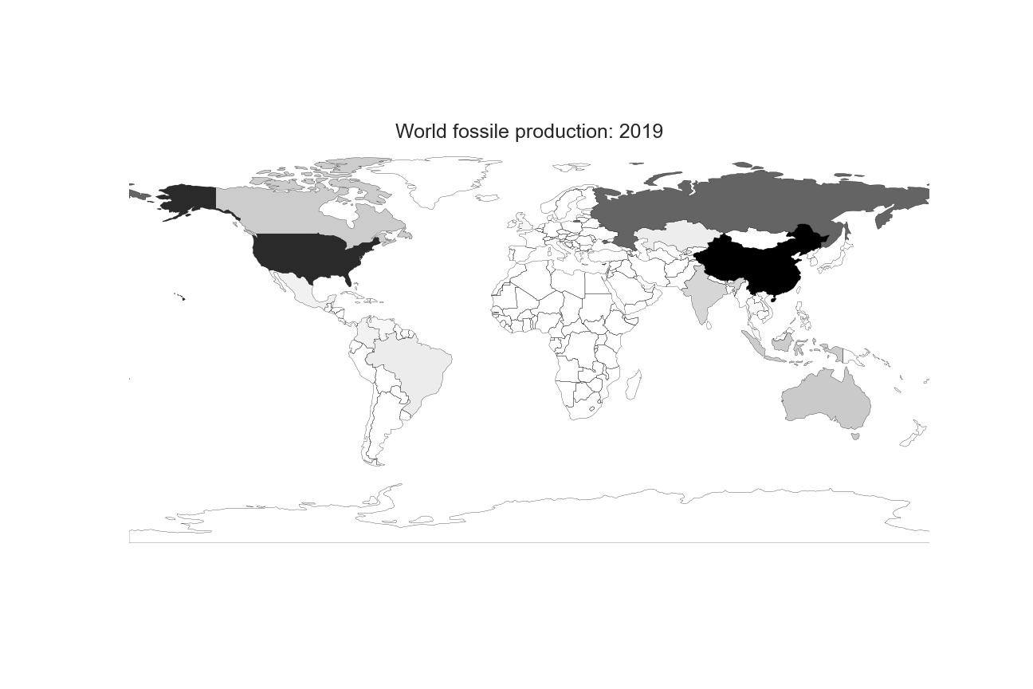
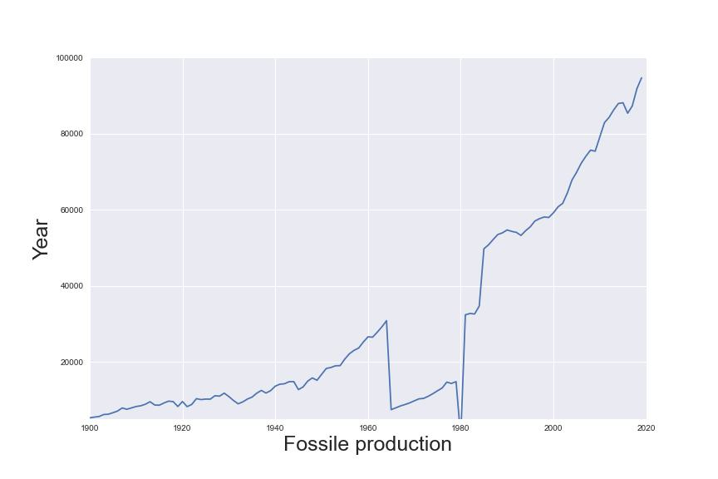
Final state
FINAL STATE

Slide 9
Main challenges
Actually getting things to work
How to display data. Normalizing over time vs. relative relations per year
Managing null values. E.g. The huge gap of information around 1960~1980
What to actually show

Slide 10
Thats it thats all!

